Slide 1

Mapping Covid-19 Israel
Michael Frenkel & Dor Yunger
10/6/2020

Slide 2
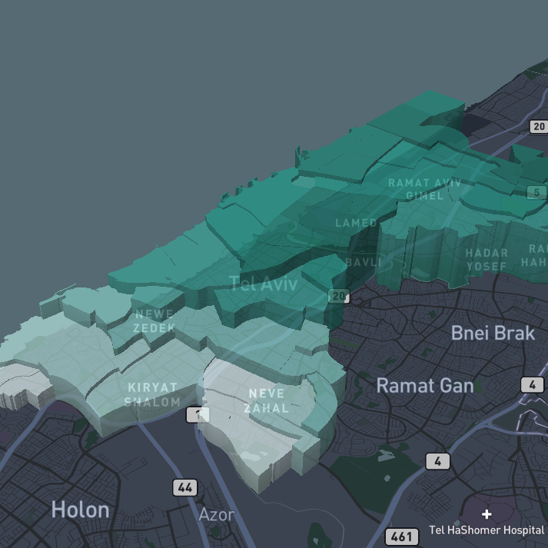
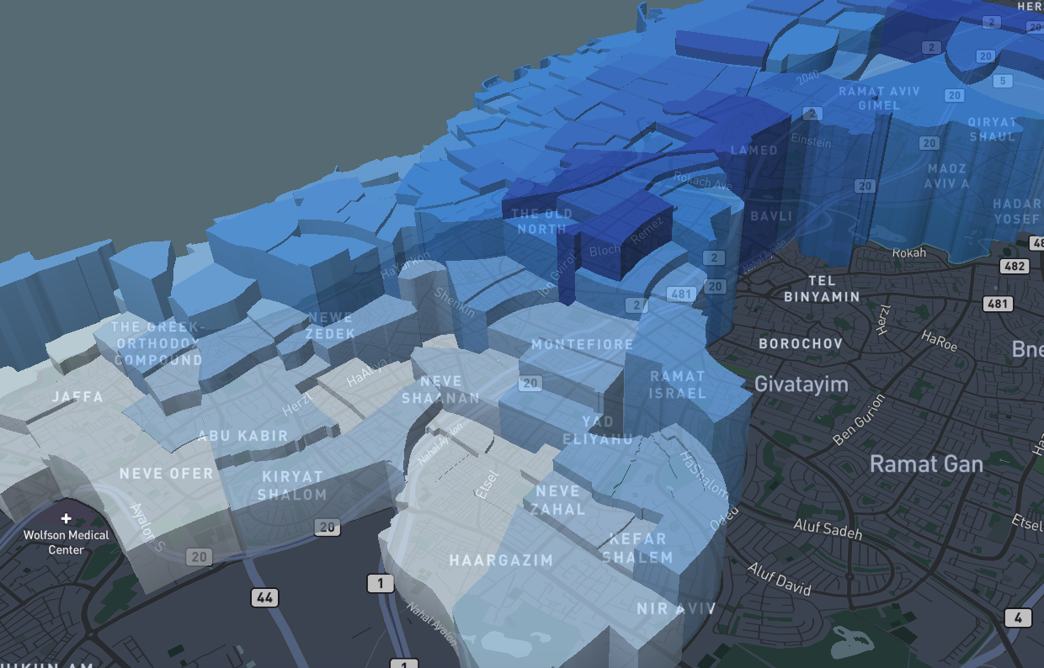
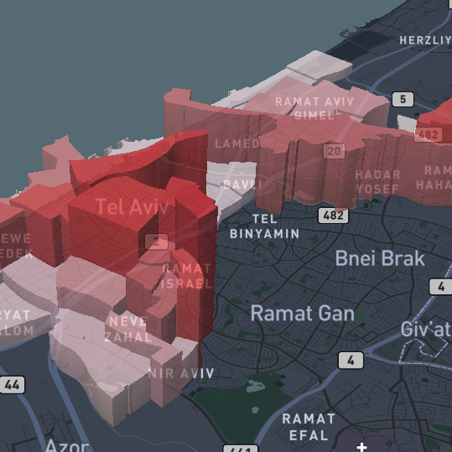
Statistical Areas TLV Example

Slide 3
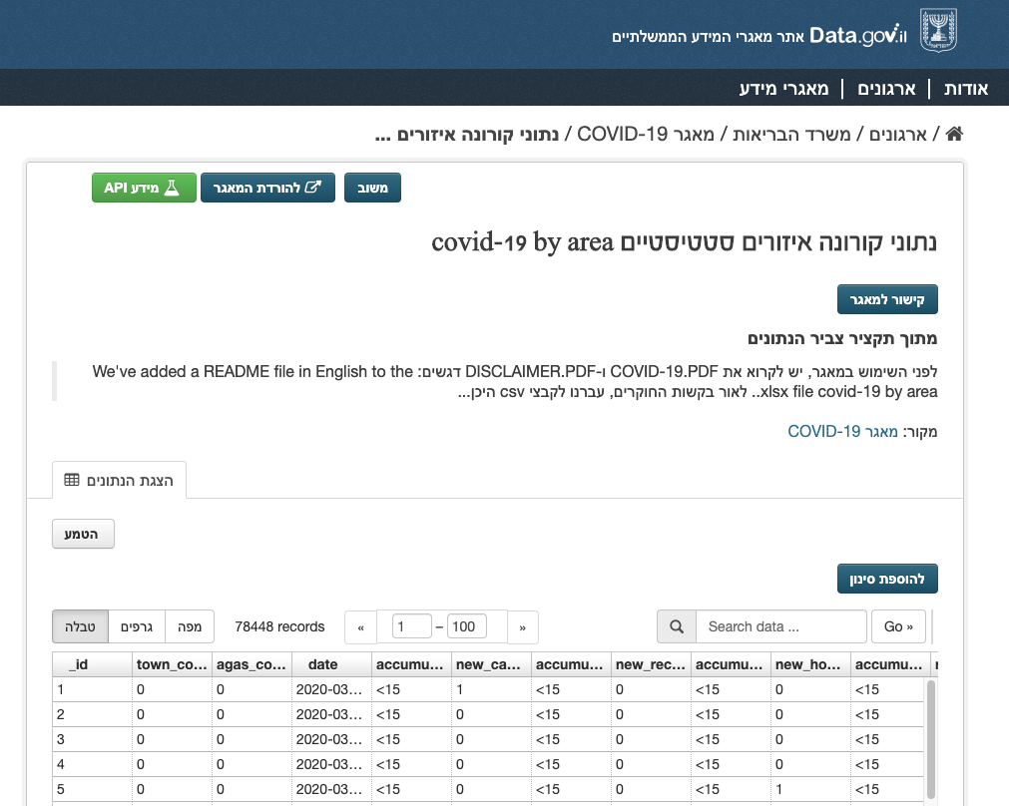
Raw Data – MOH & CSB
Statistical areas
Characterization & classification of areas
Statistical areas names

Slide 4
Data Model
Like with any dataset – preparations required
Python Geopandas to process the data
Statistical Area | Attributes | Number of Cases | Date | Geometry
123 | … | 1 | 1.5.2020 | Polygon A
123 | … | 2 | 2.5.2020 | Polygon A
… | … | … | … | …
456 | … | 1 | 1.5.2020 | Polygon B
… | … | … | … | …

Slide 5
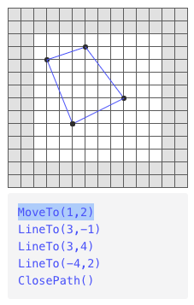
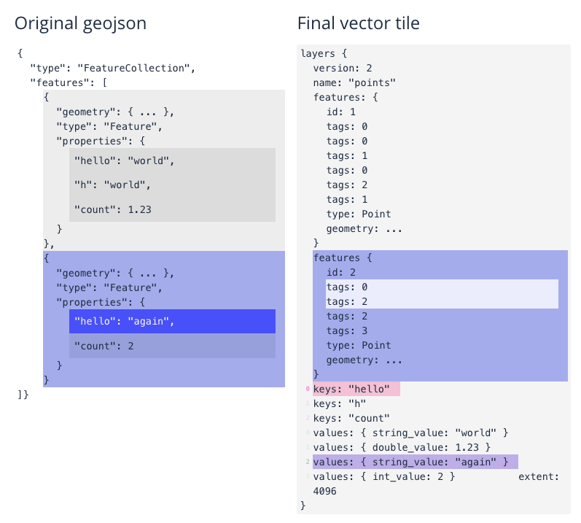
Mapbox Vector Tiles

Slide 6

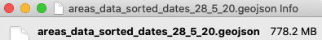
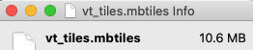


Slide 7
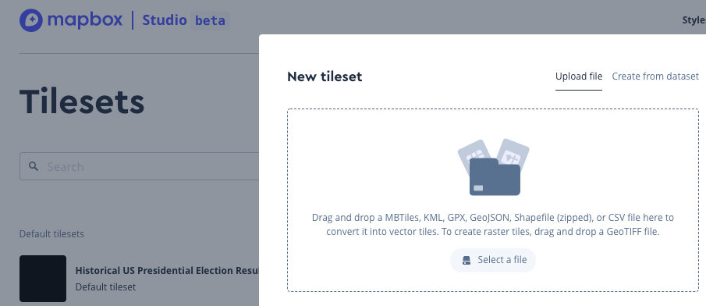
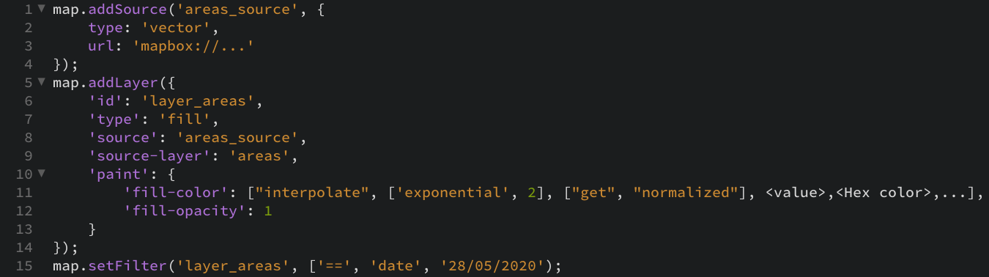
Mapbox Studio & GL JS SDK

Slide 8
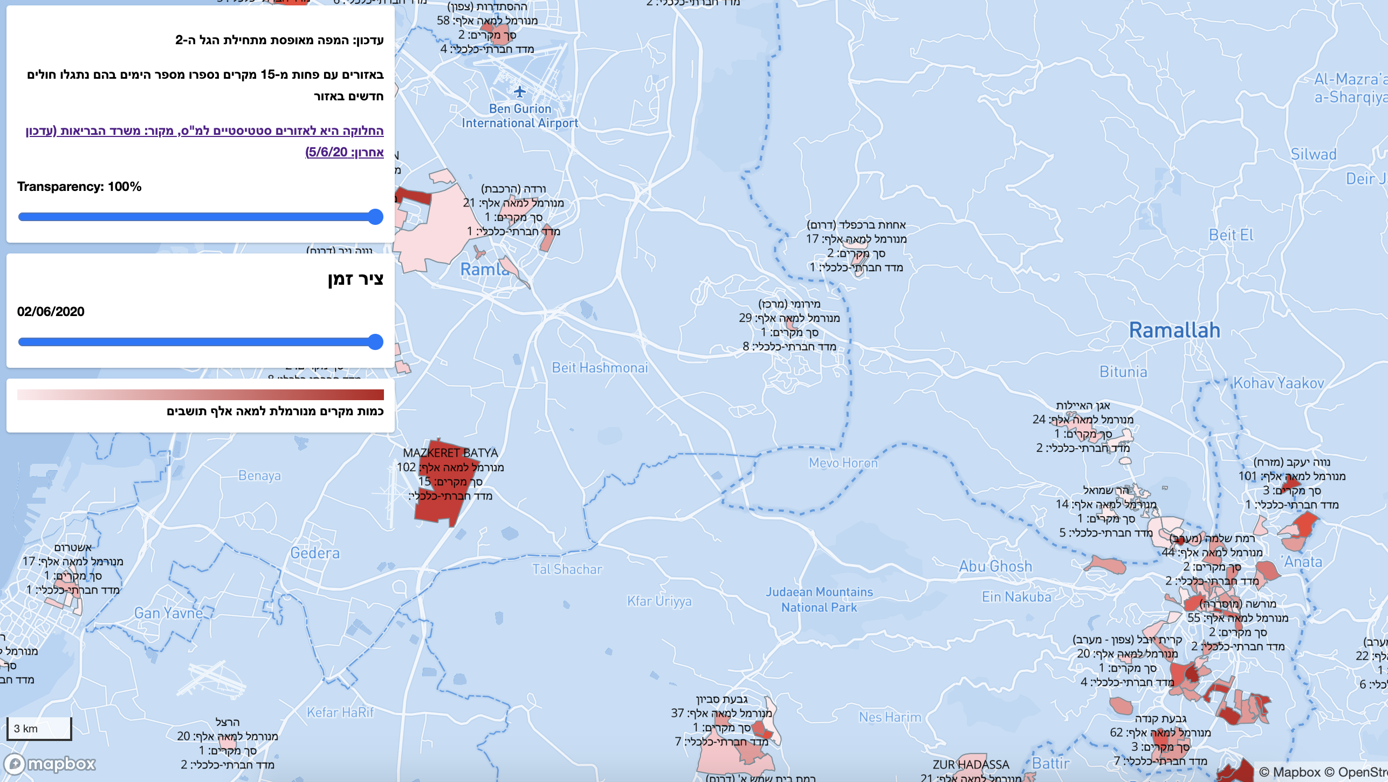
The Res‎ult

Slide 9
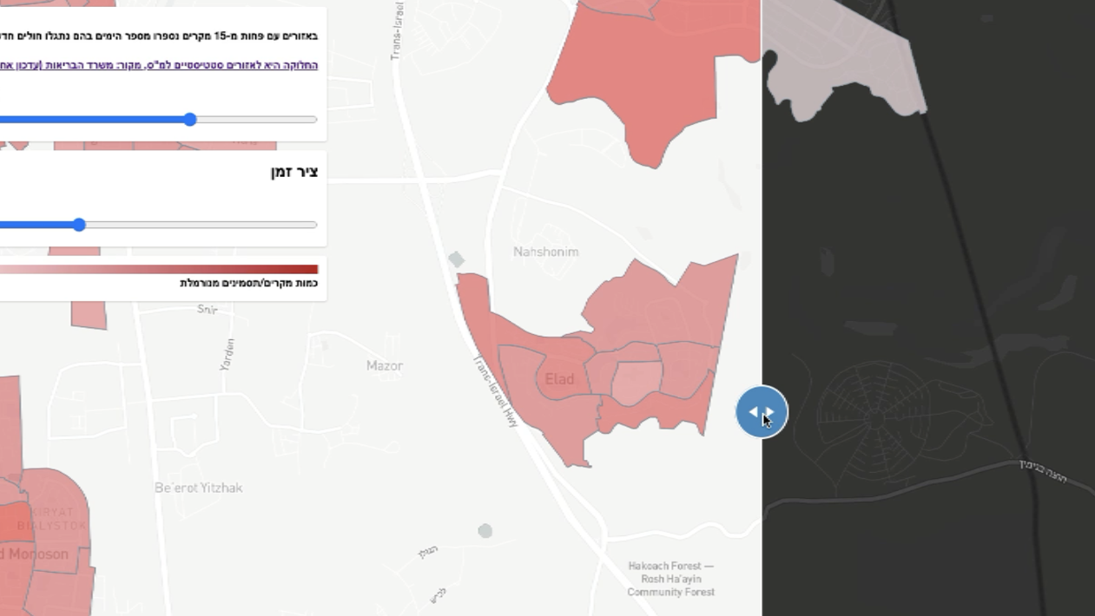
Weizmann’s & Hasadna symptoms survey prediction

Slide 10
Open public data + Open Source, it’s:
1. Engaging, many thanks to:
Dor Yunger, Gai Zomer, The public knoweldge workshop & more
2. Constructive feedback: It’s viral and people eager to see the results
3. Quick rapid maintenance and bug fixes
4. Efficient & safe way for SW: No bug will be left untouched by the crowd
clear-map.com/il

